Slide 1
Let the good grow.

Slide 2
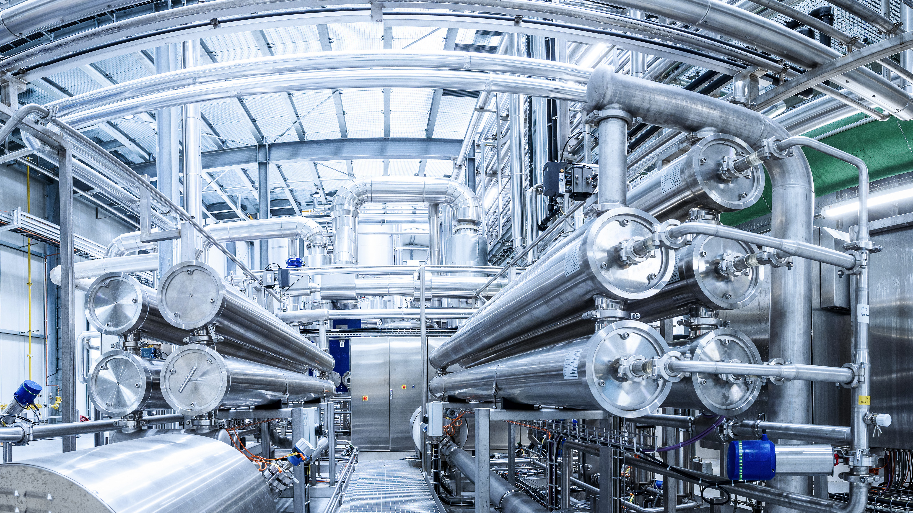

Technology changes the the game for good.
Notes:
Inhouse-First-Class-Know-how in Forschung / Wissenschaft
Profundes industrielles Network
Höchstentwickelte Produktionstechnologie (Differenziator)
Innovative patentierte Verfahren bei Funktionellen Lebensmitteln
Höhere Qualität – weniger Ressourcen – weniger Kosten

Slide 3
Die Farben gemäß PowerPoint-Designfarbenschema angepasst für NRG
Hintergrund 1 255/255/255 | Text 1 0/0/0 | Hintergrund 2 231/230/230 | Text 2 19/108/6 | Akzent 1 55/151/46 | Akzent 2 92/158/128 | Akzent 3 138/195/63 | Akzent 4 113/101/90 | Akzent 5 255/201/13 | Akzent 6 255/103/76
Dunkler 5% | Heller 50% | Dunkler 10% | Heller 80% | Heller 80% | Heller 80% | Heller 80% | Heller 80% | Heller 80% | Heller 80%
Dunkler 15% | Heller 35% | Dunkler 25% | Heller 60% | Heller 60% | Heller 60% | Heller 60% | Heller 60% | Heller 60% | Heller 60%
Dunkler 25% | Heller 25% | Dunkler 50% | Heller 40% | Heller 40% | Heller 40% | Heller 40% | Heller 40% | Heller 40% | Heller 40%
Dunkler 35% | Heller 15% | Dunkler 75% | Dunkler 25% | Dunkler 25% | Dunkler 25% | Dunkler 25% | Dunkler 25% | Dunkler 25% | Dunkler 25%
Dunkler 50% | Heller 5% | Dunkler 90% | Dunkler 50% | Dunkler 50% | Dunkler 50% | Dunkler 50% | Dunkler 50% | Dunkler 50% | Dunkler 50%

Slide 4


Icons einfärbbar

Slide 5

Shopper and Market Study by endori
A separate scientifically comprehensive qualitative study on the topic of "meat alternatives" (2022-2023).
An extract from the main results.

